Slide 1
Low Temp Krohn Hite

Slide 2
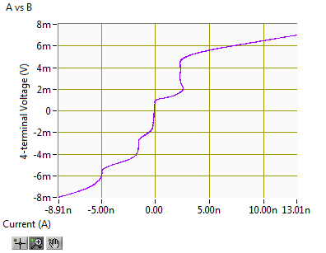
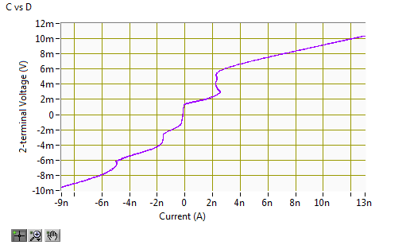
Old set-up

Slide 3
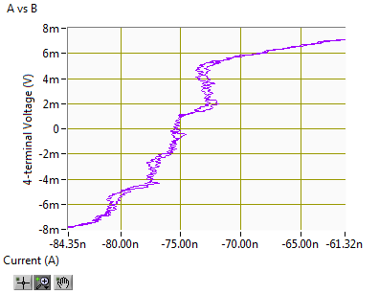
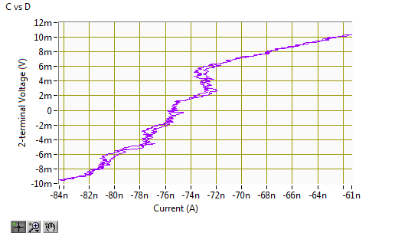
KH-current; Old method-voltage
CH1 (I- on input +, input - grounded): Diff, gain 100, 500ohm shunt, dc, filter off; IVProgram TIA gain 50000 (100*500)

Slide 4
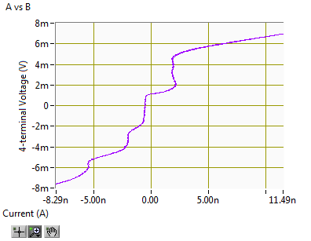
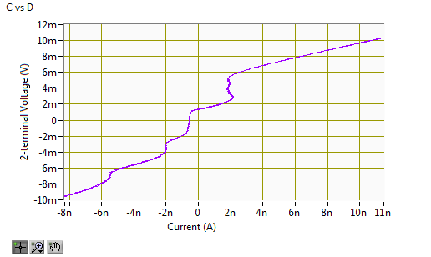
KH-current; Old method-voltage
CH1 (I- on input +, input - grounded): Diff, gain 100, 50kohm shunt, dc, filter off; IVProgram TIA gain 5000k (100*50k)

Slide 5

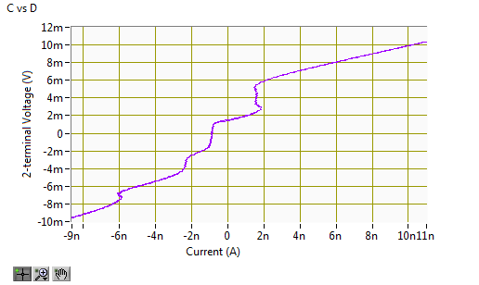
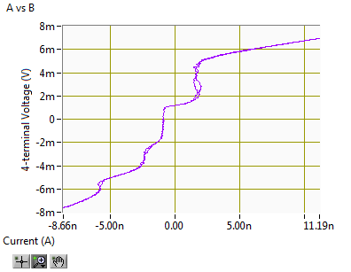

KH-current; Old method-voltage
CH1 (I- on input +, input - grounded): Diff, gain 1000, 50kohm shunt, dc, filter off; IVProgram TIA gain 50000k (1000*50k)
Sometimes a little noisy

Slide 6
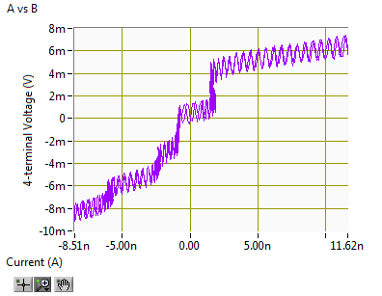

KH-current and voltage
CH1 (I- on input +, input - grounded): Diff, gain 1000, 50kohm shunt, dc, filter off; IVProgram TIA gain 50000k (1000*50k)
CH2 (V1+ on input +, V1- on input -): Diff, gain 1000, open shunt, dc, filter off; IVProgram voltage gain 1000

Slide 7
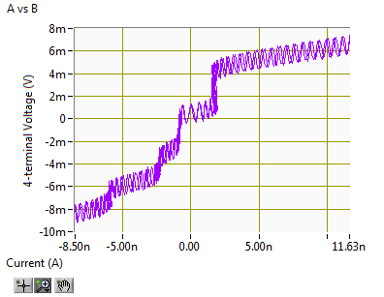

KH-current and voltage
CH1 (I- on input +, input - grounded): Diff, gain 1000, 50kohm shunt, dc, filter off; IVProgram TIA gain 50000k (1000*50k)
CH2 (V1+ on input +, V1- on input -): Diff, gain 1000, open shunt, dc, filter ON; IVProgram voltage gain 1000

Slide 8


KH-current and voltage
CH1 (I- on input +, input - grounded): Diff, gain 1000, 50kohm shunt, dc, filter off; IVProgram TIA gain 50000k (1000*50k)
CH3 (V1+ on input +, V1- on input -): Diff, gain 1000, open shunt, dc, filter off; IVProgram voltage gain 1000

Slide 9
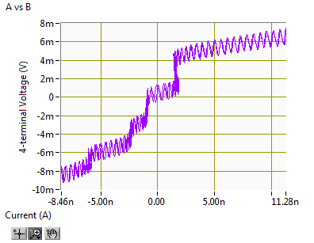

KH-current and voltage
CH1 (I- on input +, input - grounded): Diff, gain 1000, 50kohm shunt, dc, filter off; IVProgram TIA gain 50000k (1000*50k)
CH3 (V1+ on input +, V1- on input -): Diff, gain 100, open shunt, dc, filter off; IVProgram voltage gain 100

Slide 10


KH-current and voltage
CH1 (I- on input +, input - grounded): Diff, gain 1000, 50kohm shunt, dc, filter off; IVProgram TIA gain 50000k (1000*50k)
CH3 (V1+ on input +, V1- on input -): Diff, gain 100, open shunt, dc, filter ON; IVProgram voltage gain 100

Slide 11
AO0
AO0
V+_{F}
AO0
V-_{F}
I-_{F}
V+_{F}
V+_{KH}
R
V-_{F}
V-_{KH}
V+_{KH}
I = output / (gain * R)
R
Output = ΔV*gain
V-_{KH}
I = output / (gain * R)

Slide 12
CH1
CH1
V+_{KH}
V+_{KH}
V_{diff}->0-AI0
V_{diff}->0-AI0
V+_{Femto}
V-_{KH}
V-_{KH}
V+_{KH}
AO0
AO0
CH3
V-_{Femto}
V-_{KH}
V+_{KH}
V+_{KH}
V_{diff}->0-AI1
V_{diff}->0-AI1
AO1
V-_{KH}
AO1
V-_{KH}
CH2
CH2

Slide 13
CH1
V+_{KH}
V_{diff}->0-AI0
V+_{KH}
V-_{KH}
CH3
ground
AO0
V+_{KH}
CH4
ground
V+_{KH}
V_{diff}->0-AI1
AO1
V-_{KH}
CH2

